Slide 1
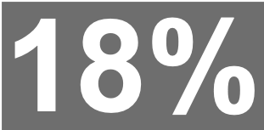
Magazine Brands (General Monthlies)

