Slide 1
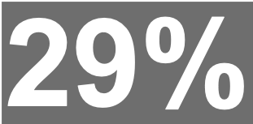
Magazine Brands (General Weeklies)

