Slide 1
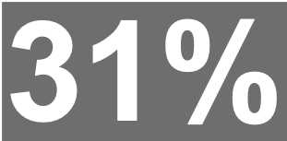
Magazine Brands (Women’s Weeklies)

