Slide 1
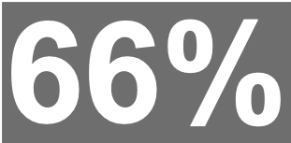
Newsbrands (Populars)

